Slide 1
Traversing a List #1
A supplemental lesson for AP CSP

Slide 2
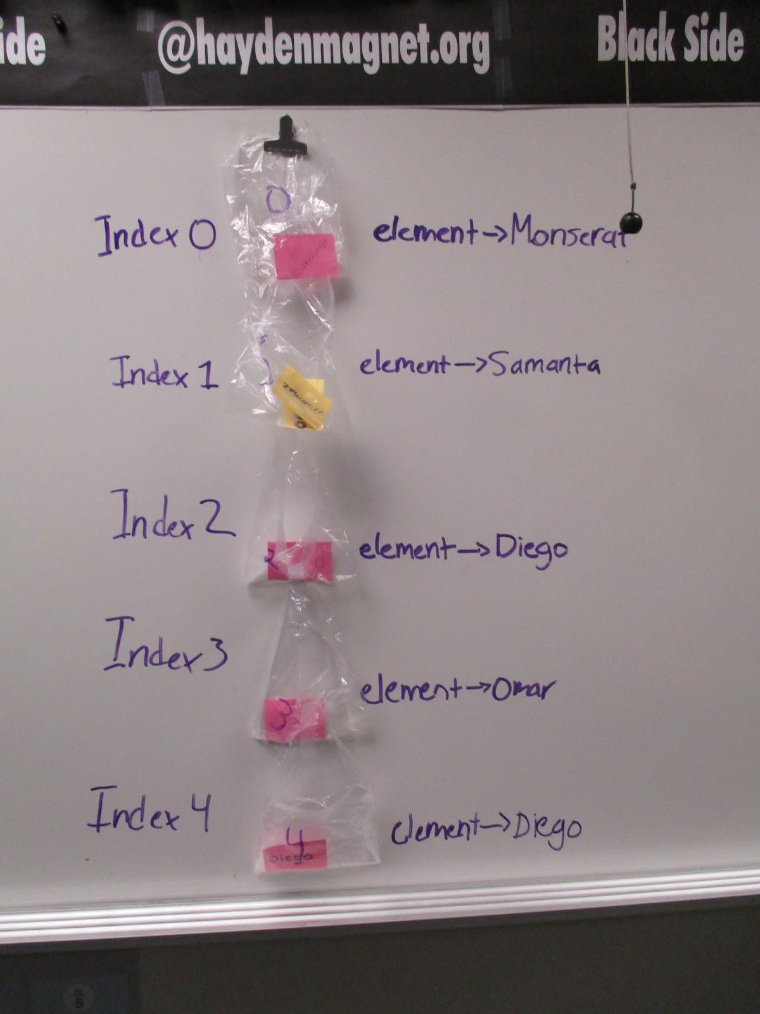
Warm-up
You have used lists for several assignments now.
What do you remember about lists?

Slide 3
Traversing a list
Mission 7 Billboard and Mission 8 Answer Bot both used lists.
In Mission 7, you scrolled through the list one item at a time using the left and right buttons.
In Mission 8 you selected a random item from the list.
But sometimes you want to access every element in a list – in order.
This is called “traversing.”

Slide 4
Traversing a list
Traversing means to travel, or traverse, through a list one element at a time in order.
To traverse a list you use a loop to:
Start with the first index (0) and access that item.
Continue accessing each item in order until the last index (length of list - 1) is reached.
This technique is sequencing.

Slide 5
Traversing a list
Traversing a list can be very useful in many ways.
Some reasons are:
Display all items in a list, one at a time, like a slideshow.
Looking through a list to see if a particular value is an item in the list.
Create a sub-list from the complete list, like all numbers less than 10.
Let’s practice traversing a list in some of our programs.

Slide 6
Traversing a List: Example #1
In CodeSpace, open Answer_Bot_parameters (or your latest version of Answer_Bot).
Use the sandbox.
Go to File → Save As… and rename the program Answer_Bot_traversal
You will add another function to the program.

Slide 7

Traversing a List: Example #1
Right now the program selects a random item from the list when a button is pressed.
You will add a function to traverse the list, displaying all the items one at a time, like a slideshow.
To traverse a list, you need a loop.
Create a function and initialize the index to use in a loop.

Slide 8
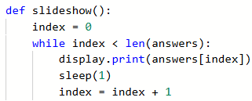
Traversing a List: Example #1
Complete the function by using a while loop to access each item in order.
Compare index to the length of the list.
Use the index to access the item and display it.
Increment the index.

Slide 9

Traversing a List: Example #1
In the Main Program
Add an if statement for a button press that calls the function.
Run the code and see how it works by pressing the new button.

Slide 10
Traversing a List: Example #1
When traversing a list, you know exactly how many times the loop will execute.
It is always the length of the list.
So, there is a shorter way to traverse a list.
Introducing … the for loop!
A for loop embeds initializing and incrementing the loop control variable in its structure so you don’t have to explicitly write the code for it.
By default, a for loop starts at 0 (perfect for a list index!)
A for loop continues incrementing one at a time until one less than a range (just like randrange!).

Slide 11

Traversing a List: Example #1
Modify the slideshow() function by changing the while loop to a for loop.
Delete the index initialization.
Change the while to a for.
Change the condition to range().
Delete the increment.

Slide 12
Traversing a List: Example #1
Run the code again.
The loop automatically starts at 0.
The loop goes up to but does not include the range, so len(answers) is perfect.

Slide 13
Traversing a List: Example #1
One way the list manages complexity is by using len(answers) in the range.
If the list is modified – elements are added or removed – the code doesn’t need to be changed.
It will automatically traverse the list of any size.

Slide 14

Traversing a List: Example #1
Since this is done so regularly, there is an even faster way to traverse a single list.
This specialized for loop accesses each element in order and doesn’t need to reference the index.
Modify your function to use the new structure:

Slide 15
Traversing a List: Example #1
Compare the two loops:
For loop
Uses index as the loop control variable
Uses the length of the list for the range
Access the item by using the index
Specialized for loop
Uses item (or any descriptive variable) as the loop control variable
Uses the list for the range
The loop control variable is the item, no need to use index.

Slide 16
Traversing a List: Example #1
So what’s the difference?
The for loop uses an index to access each item in the list.
The specialized for loop accesses each item and doesn’t use the index in the code.
If you just want to traverse a list and don’t need to know the index, the specialized for loop works great.
If you need to know the index, then the specialized for loop won’t work.
You will see examples of this during the lesson.

Slide 17
Traversing a List: Example #2
Let’s traverse a list in another program.
In CodeSpace, open Billboard_functions (not the version with a parameter).
Use the sandbox.
Go to File → Save As… and rename the program Billboard_traversal
With a slideshow, you will want a short delay between each item, so add: from time import sleep
near the top of your code.

Slide 18
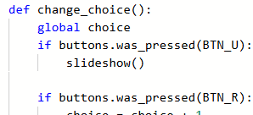
Traversing a List: Example #2
Add a slideshow() function to traverse the list.
  Try using a specialized for loop.
  Include the if statement from the display_item() function.
  How much can you do on your own? Give it a try!
Then go to change_choice() and add an if statement for a button press to call the slideshow.

Slide 19
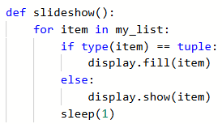
Traversing a List: Example #2
How did you do?
Does your function look similar to this?
If it doesn’t, that is okay. There are many different ways to accomplish the same task.
Run your code and verify it works as expected.

Slide 20
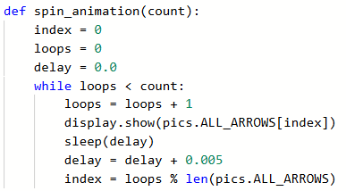
Traversing a List: Example #3
Let’s revisit traversing a list in the Game Spinner program.
In CodeSpace, open Game_Spinner. Save As the program and name it Game_Spinner_traversal.
Use the sandbox.
Take a look at the function that traverses a loop:

Slide 21
Traversing a List: Example #3
There is a lot going on here!
Let’s simplify things by just traversing the list ONE time using a specialized for loop.
What code will you take out, and what will you change?
Give it a try.

Slide 22
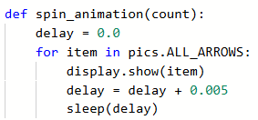
Traversing a List: Example #3
How did you do?
Does your function look something like this?
Run the code and verify it works as expected.
It should display all 8 arrows and then a random arrow.

Slide 23
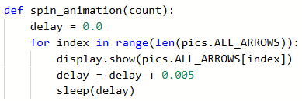
Traversing a List: Example #3
A specialized for loop certainly works, but it only traverses the list one time.
That is 8 arrows.
The argument indicates viewing 30 arrows.
Change the loop to a regular for loop. It might look similar to this:

Slide 24
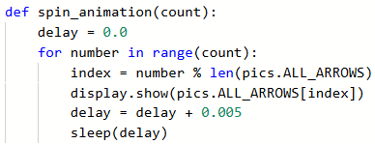
Traversing a List: Example #3
This works, but it is basically the same as the specialized loop. Did you notice that?
It still traverses the loop only one time.
In this case, the for loop needs to use the parameter.
Separate the loop control variable from the index.
This is a good time to use modulo division!

Slide 25
Traversing a List: Example #3
This is a great time to use modulo division!
Remember – modulo division can limit the possible values.
  x % 5 : possible values are 0, 1, 2, 3, 4
  x % 9 : possible values are 0 to 8
  index % len(my_list) : possible values are 0 to
  1 less than the list length
  These possible values are the index of the list!
You can use modulo division so the index does not exceed the number of elements.
  Use the len() of the list as the divisor.

Slide 26
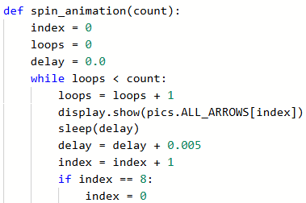
Traversing a List: Example #3
Run the code and verify it works as expected.
Take a look at the original while loop and compare it to the for loop you ended up with.
Using a for loop and modulo division shortens the code, makes it easier to read, and easier to and modify.

Slide 27
Wrap Up
Complete the Wrap-Up questions on your Activity Guide.

